Slide 1
A conversation on future embedded systems

Slide 2
Post questions on slack channel
#sigcomm2020-panel-embedded
Notes:
While you can use the zoom Q&A feature, I would encourage everyone to post..

Slide 3
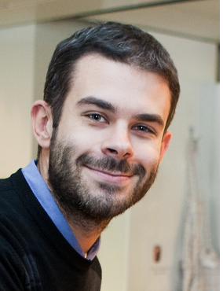

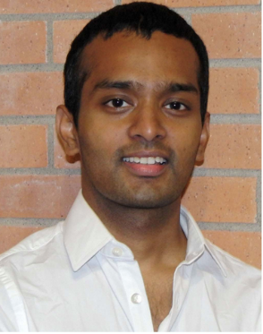
Shyam Gollakota
University of Washington
Luca Mottola
Politecnico di Milano
Tanzeem Choudhury
Cornell Tech

Slide 4
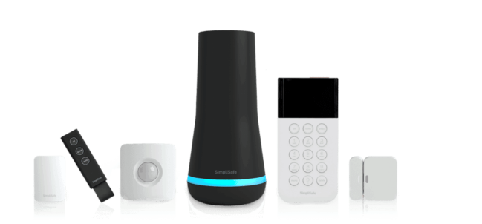
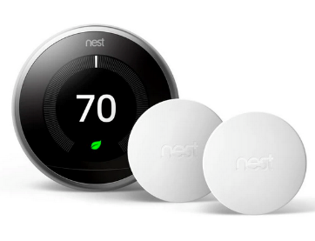
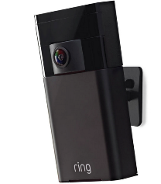
Embedded systems
Embedding computing, sensing and communication into everyday objects
Notes:
If we think about it, we’re surrounded by insects every day doing all kinds of incredible things. That little fly on your kitchen counter can do complex loops in the air better than any human pilot, and the bees or ants in your garden can carry huge weights for their size.

Slide 5
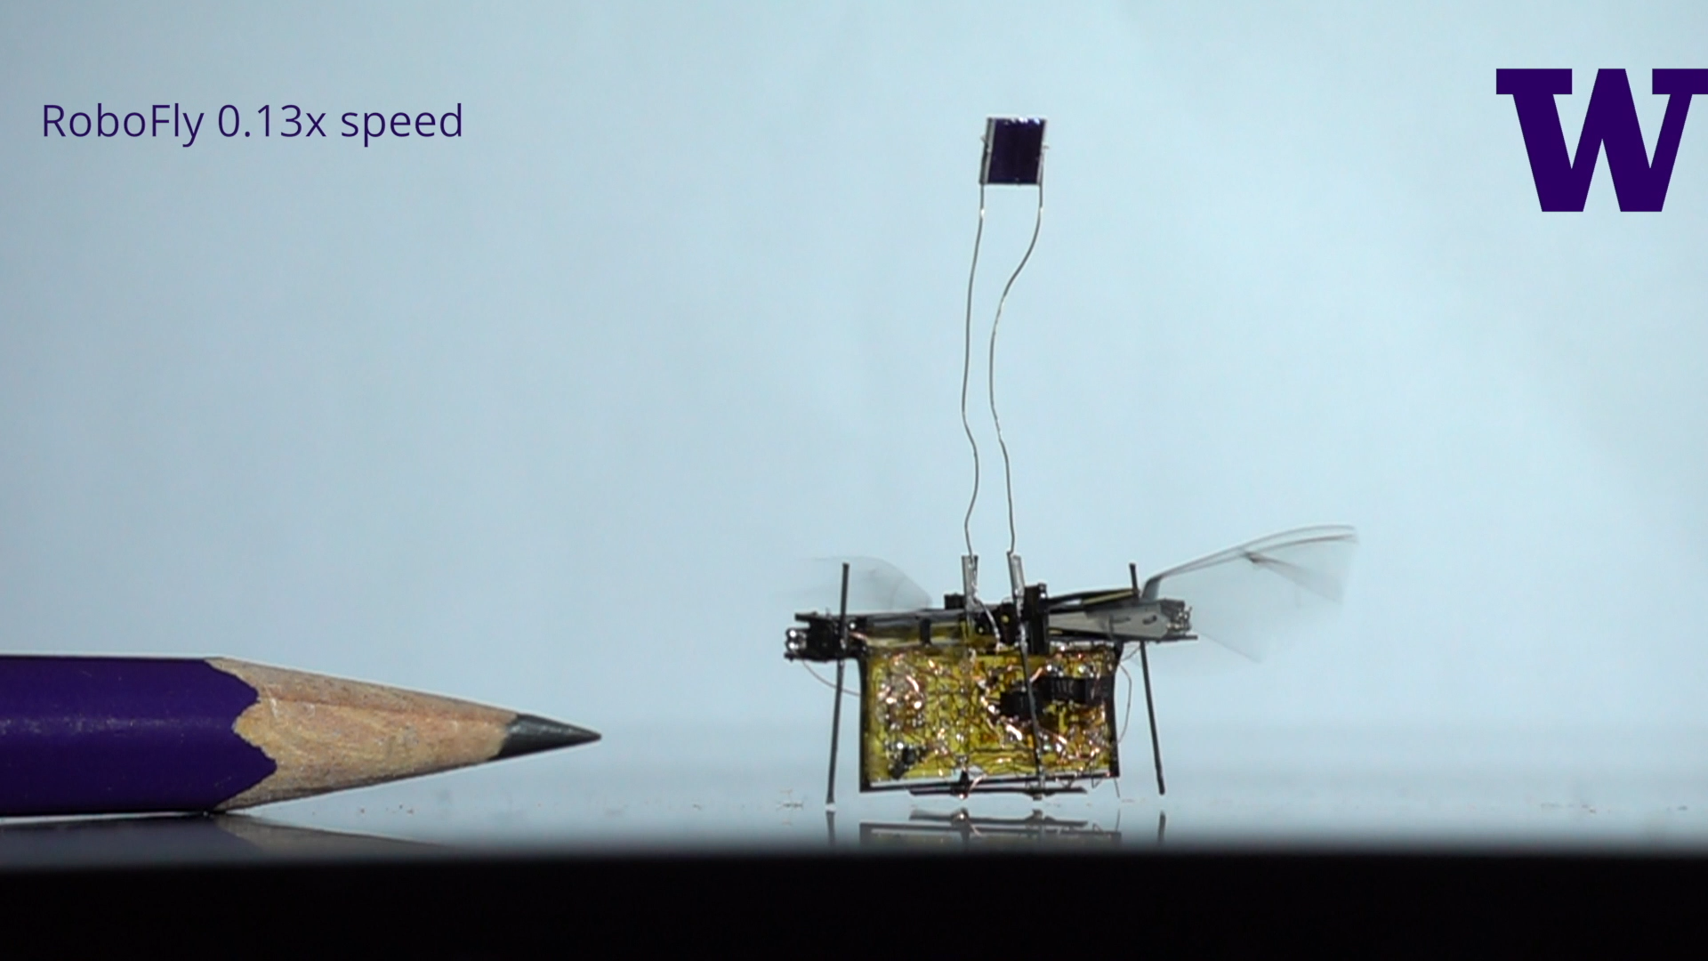


Next-Gen Embedded systems
Tiny embedded systems that can move
[ICRA’18]
Wireless systems embedded with living insects
[MobiCom’19]
Hybrid insect-robot embedded systems
[Science Robotics’20]
Notes:
If we think about it, we’re surrounded by insects every day doing all kinds of incredible things. That little fly on your kitchen counter can do complex loops in the air better than any human pilot, and the bees or ants in your garden can carry huge weights for their size.

Slide 6
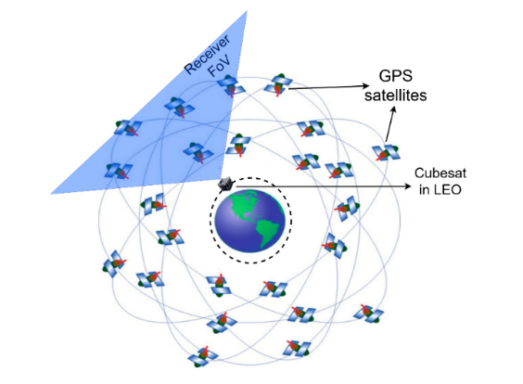
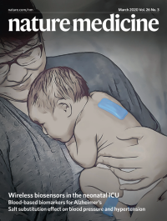
Next-Gen Embedded systems
Wireless systems embedded into nano-satellites
[MobiCom’20]
Embedded and mobile
systems for healthcare
Notes:
Capturing a panorama and achieve a wide angle view of what the insect is seeing.

Slide 7
Beyond the Cloud(s):
Embedded Software for Nanosatellites
Luca Mottola Politecnico di Milano, Italy and RI.SE, Sweden

Slide 8

Nano…what?

Slide 9
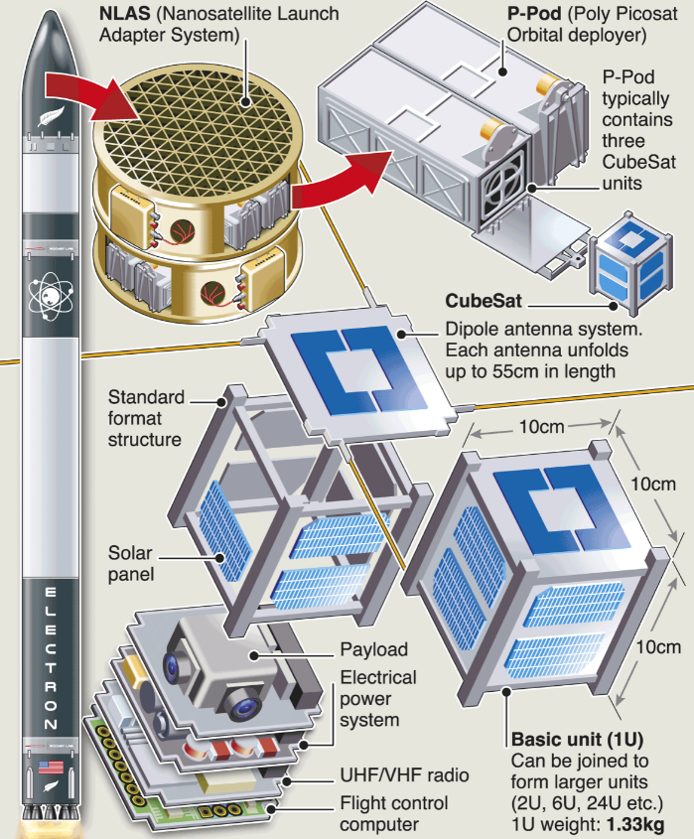

Slide 10


Slide 11
Research

Slide 12
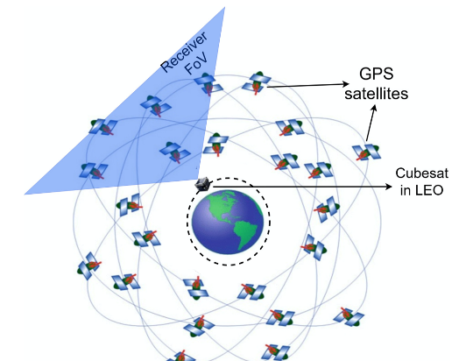
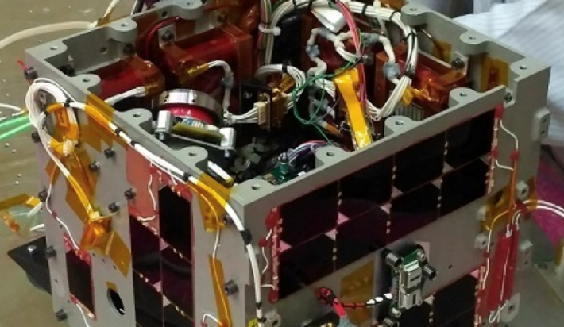
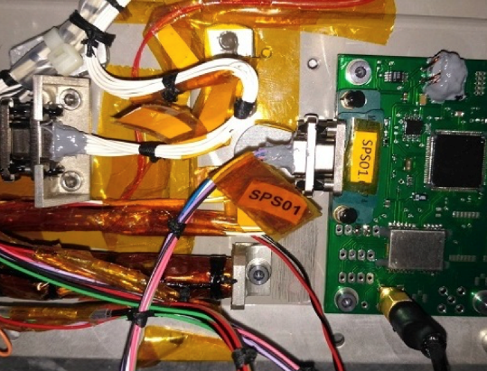

Slide 13

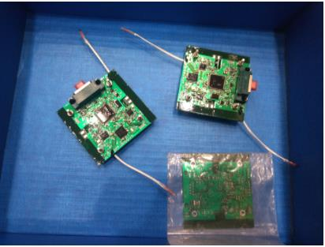
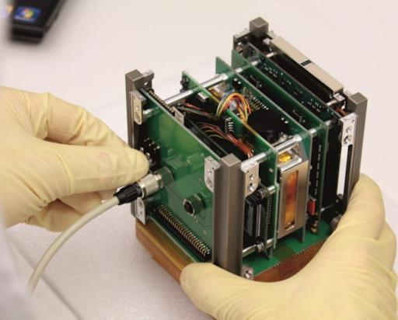
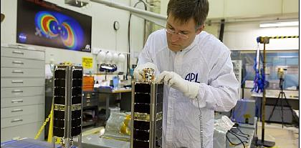
Notes:
@@@@@

Slide 14
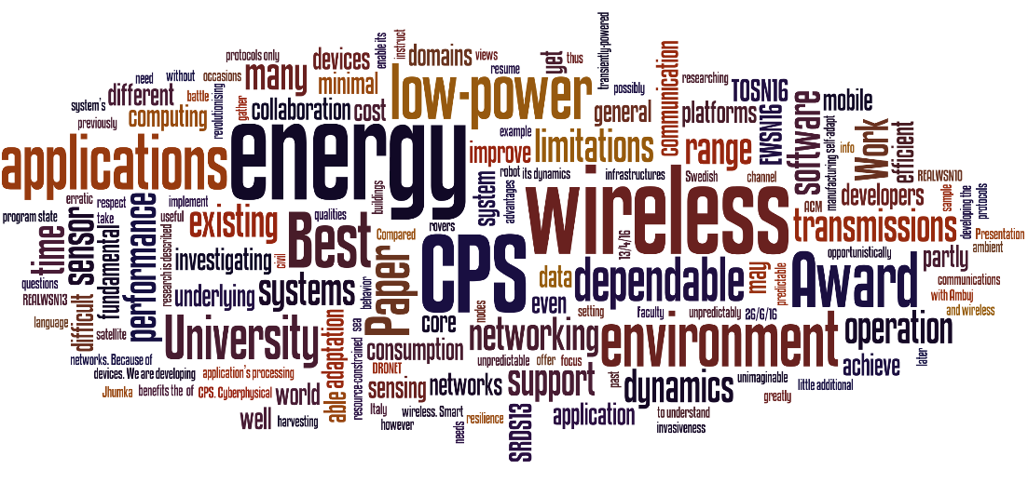
www.neslab.it

Slide 15

Towards Immersive Health
Tanzeem Choudhury

Slide 16

technical advances
clinical advances

Slide 17


Slide 18
Intervention Gap

Slide 19
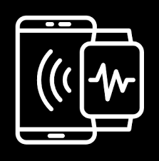

Sensing and Intervention not coupled beyond simple bookkeeping

Slide 20
Sensing and Intervention not coupled beyond simple bookkeeping

Slide 21



Paper
More than tracking?
Phone
Invisible

Slide 22
Health intervention technologies often expect too much from us

Slide 23
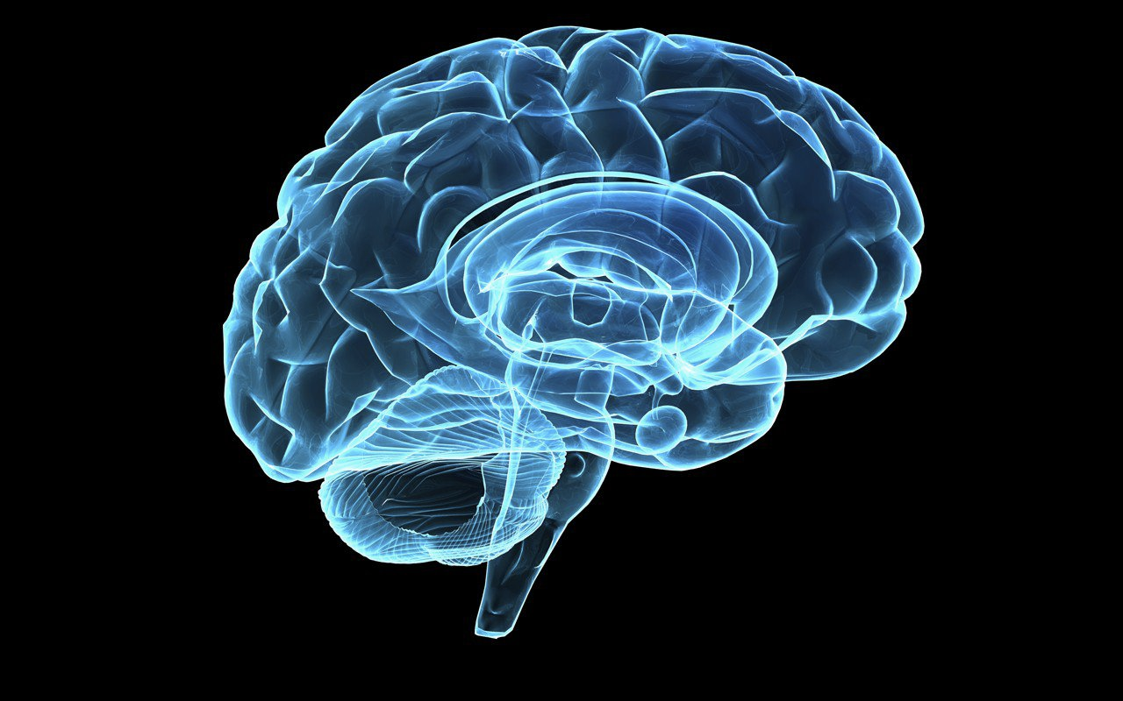
Can we design technologies that do not require conscious awareness of the user to be effective?

Slide 24
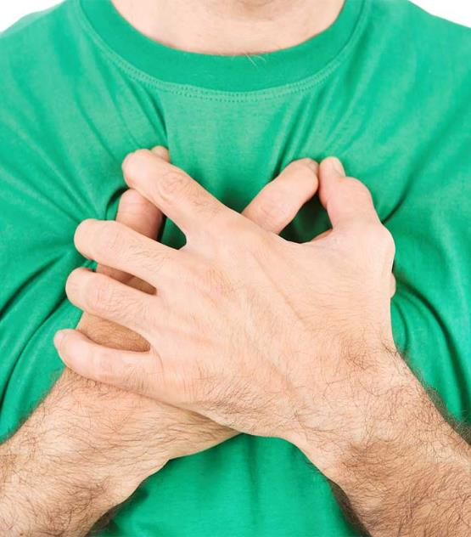

Interoceptive awareness
=
Sense of internal bodily changes
Notes:
Our environment contains significant cues that can trigger fast and automatic emotional responses. Furthermore, the way we perceive what happens in our bodies can also trigger fast emotional reactions.
It’s a dual way connection. So when you notice that your heart rate is pounding, or when you are blushing, sweating, all these things can intensity the feelings the anxiety and nervousness. This happens even without our conscious awareness.

Slide 25
BoostMeUp: Leveraging Bodily Signals to Reduce Anxiety and Improve Performance in Real-time

Slide 26


The vibrations represent your current heart rate
110 bpm
1.83 Hz

Slide 27
The vibrations represent false heart rate feedback
110 bpm
1 Hz

Slide 28
Anxiety Level

Slide 29
Changes in Heart Rate

Slide 30
Number of Correct Answers

Slide 31

Parallel not serial

Slide 32

Reflexive not reflective

Slide 33

Focus on triggers

Slide 34
Post questions on slack channel
#sigcomm2020-panel-embedded
Notes:
While you can use the zoom Q&A feature, I would encourage everyone to post..

